Slide 1
Chapter 2
The Basic Concepts of Set Theory
Section 2.3
Set Operations

Slide 2
Set Operations
Determine intersections of sets
Determine unions of sets.
Determine the difference of two sets.
Understand ordered pairs and their uses.
Determine Cartesian products of sets.
Analyze sets and set operations with Venn diagrams.
Apply De Morgan’s laws for sets.

Slide 3
Intersection of Sets
The intersection of sets A and B, written
is the set of elements common to both A and B, or:
Here is the symbol for “intersection”
Find each intersection.
a)
b)
Solution
a)
b)
Example – Intersection of Sets
Intersection involves the OVERLAP of the sets.

Slide 4
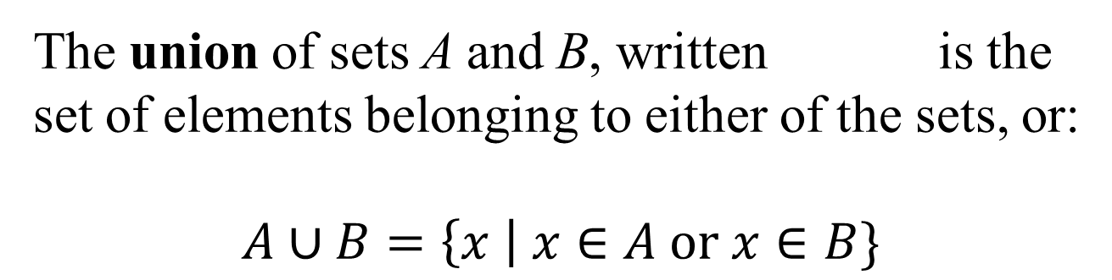
Union of Sets
Here is the symbol for “union”
Find each union.
a)
b)
Solution
a)
b)
Example – Union of Sets
Union involves the ALL the elements from ALL of the sets (don’t include duplicates).

Slide 5
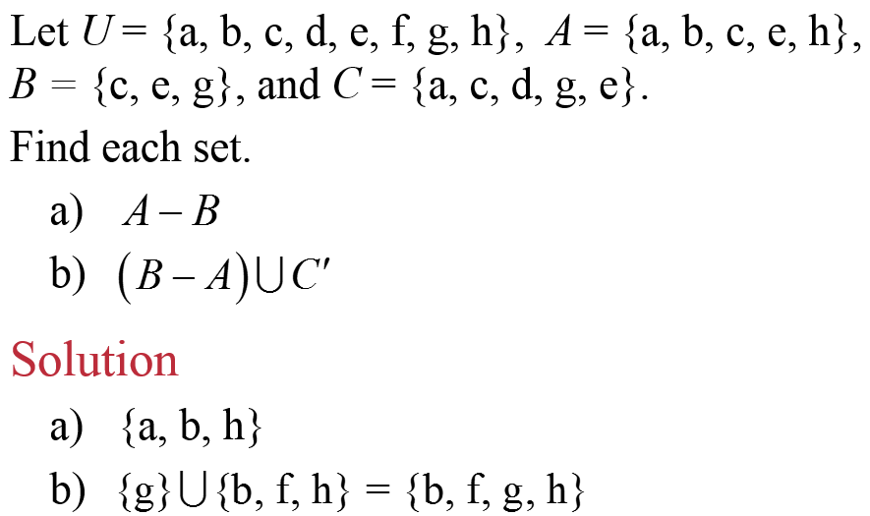
Difference of Sets
The difference of sets A and B, written A – B,
is the set of elements belonging to set A and not to set B, or:
Example – Finding the Difference of Sets
Difference (subtract) involves “taking away”.
For A – B, it means take away from A anything that is also in B.

Slide 6
Ordered Pairs and Cartesian Product of Sets
In the ordered pair (a, b), a is called the first component and b is called the second component. In general
Two ordered pairs are equal provided that their first components are equal and their second components are equal.
The Cartesian product of sets A and B, written (read as “A cross B”) is:

Slide 7
Example: Finding Cartesian Products
Let A = {a, b}, B = {1, 2, 3}.
Find each set.
a)
b)
Solution
a) {(a, 1), (a, 2), (a, 3), (b, 1), (b, 2), (b, 3)}
b) {(1, 1), (1, 2), (1, 3), (2, 1), (2, 2), (2, 3),
(3, 1), (3, 2), (3, 3)}
Cartesian Product (ordered pair) involves “pairing up”.
For A × B, pair up each element of A, one at a time, with each element of B, one at a time.

Slide 8
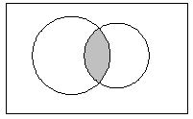
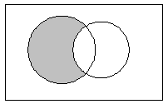
Venn Diagrams of Set Operations
Shade only in the OVERLAP of A and B.
Shade everything in ALL of A and B.
A
B
A
B
U
U
Shade all that is NOT in A.
Take away from (shaded) A anything also in B.
A
A
B
U
U

Slide 9
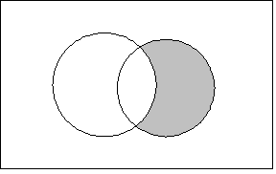
Example: Shading Venn Diagrams to Represent Sets
Draw a Venn Diagram to represent the set
Solution
Shade not in A but also in B.
Try reversing it: B ∩ A’
means start with B, while at the same time, leave out anything from A.
A
B
U

Slide 10
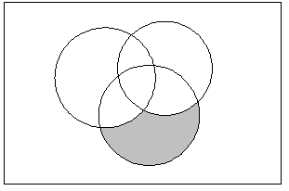
Example: Shading Venn Diagrams to Represent Sets
Draw a Venn Diagram to represent the set
Solution
Follow the order of operations here.
(A’∩ B’) means shade what’s NOT in A as well as NOT in B at the same time.
B
A
Then, from that, include only what overlaps with C.
C
U

Slide 11
De Morgan’s Laws ** NOTECARD !! **
For any sets A and B:

